Slide 1
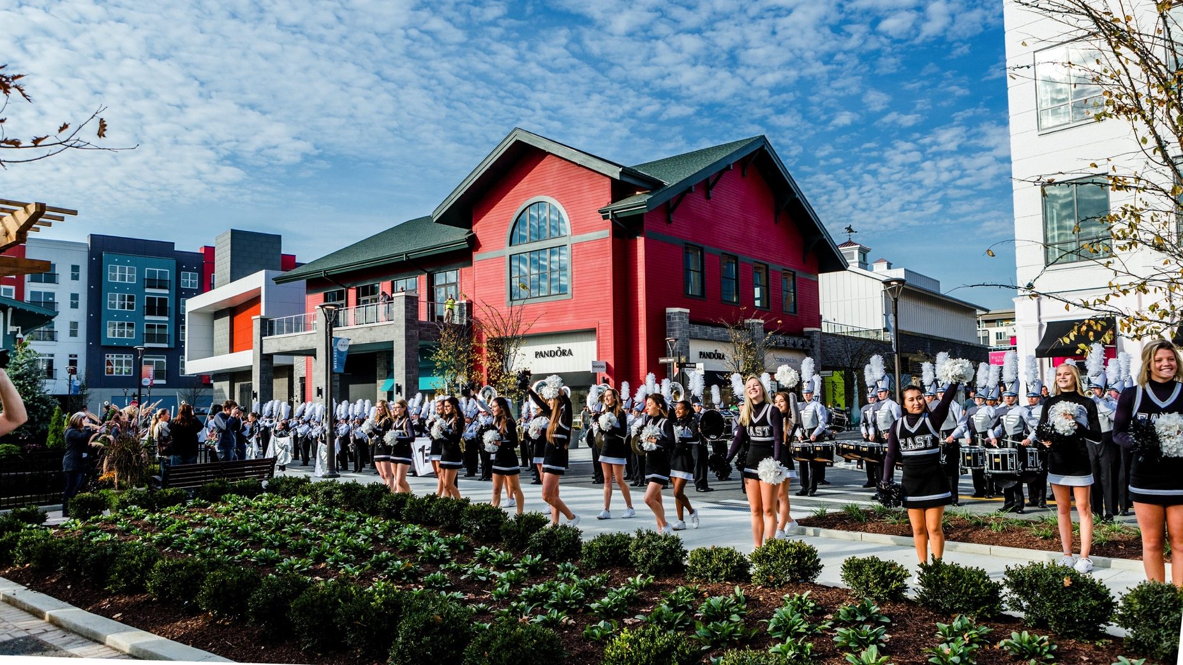
LIBERTY CENTER: CASE STUDY
CREATION OF A SUSTAINABLE MIXED-USE ENVIRONMENT
Yaromir Steiner
October 14, 2017

Slide 2
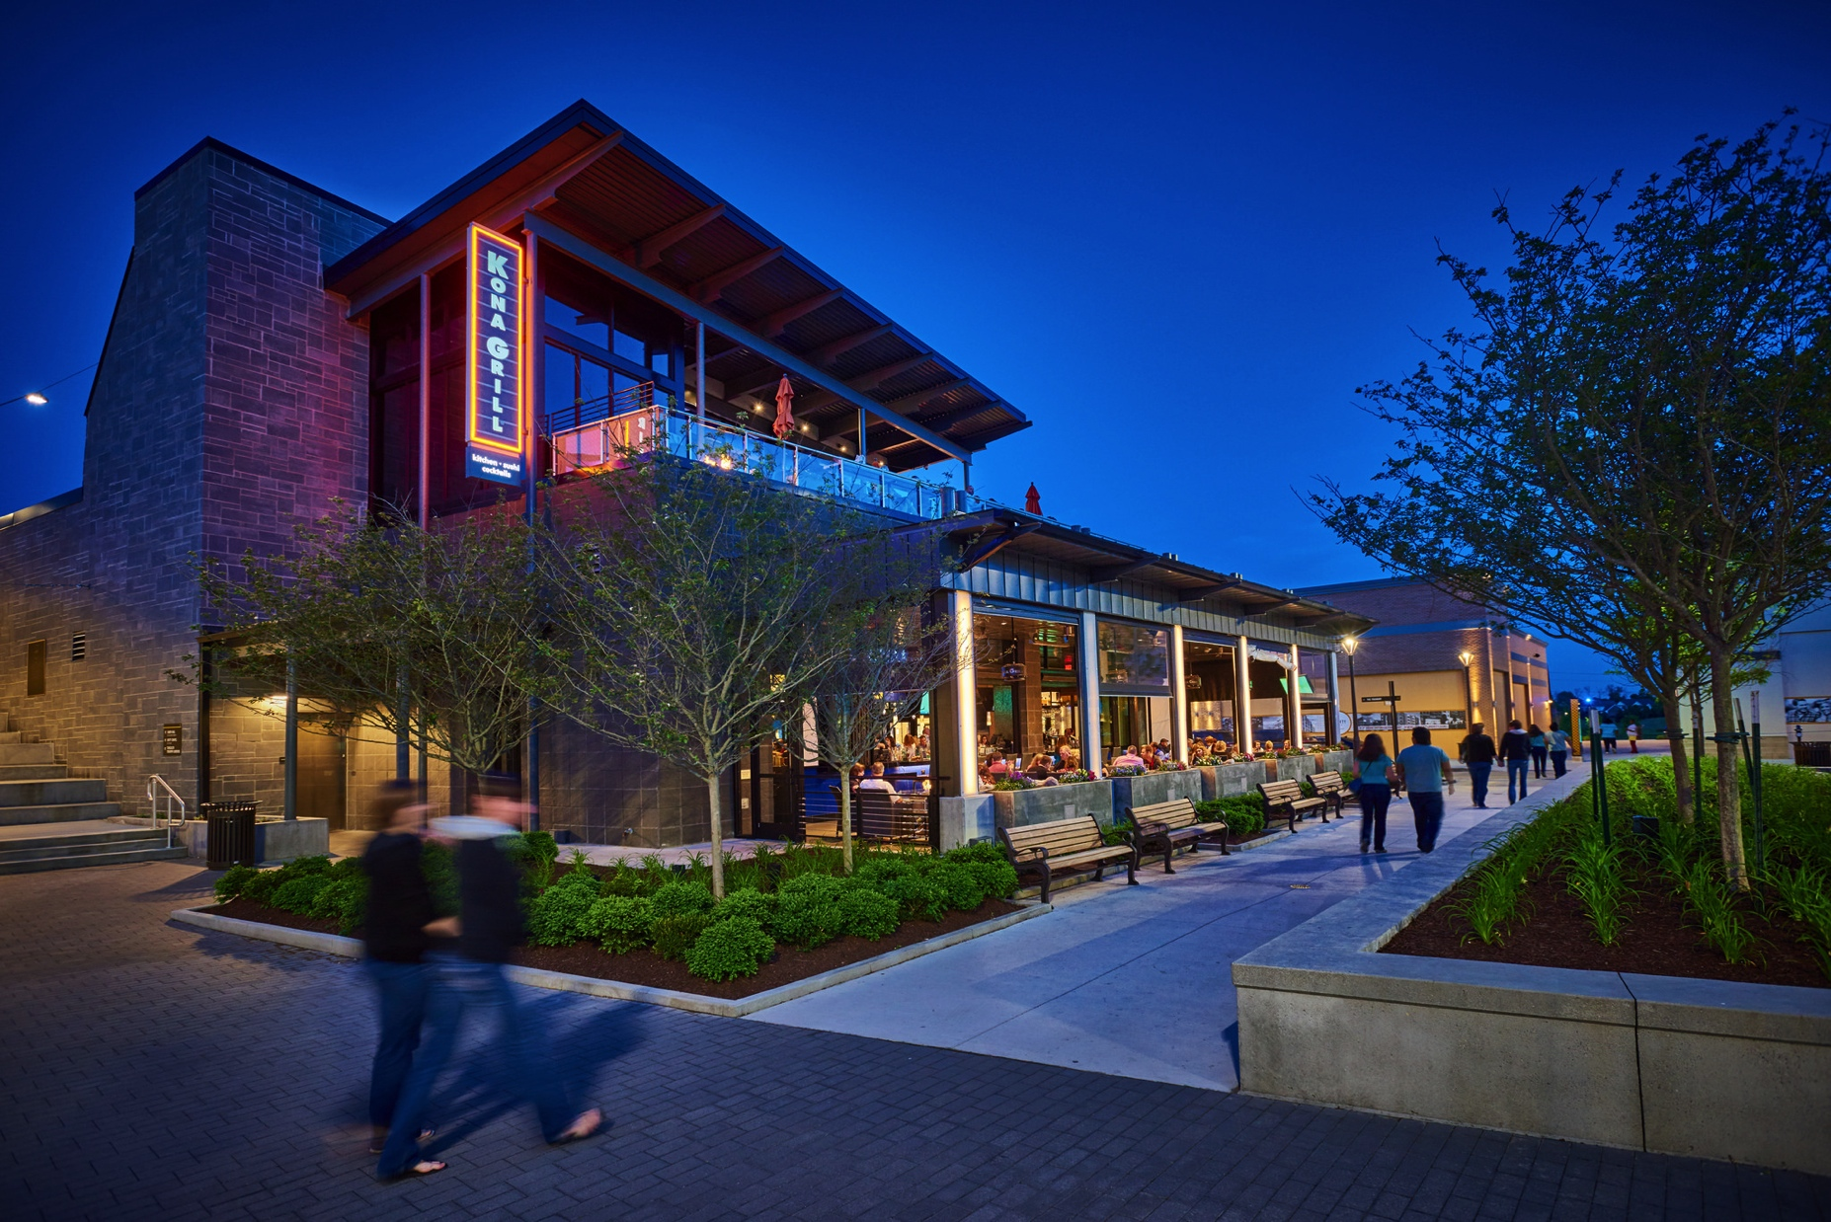
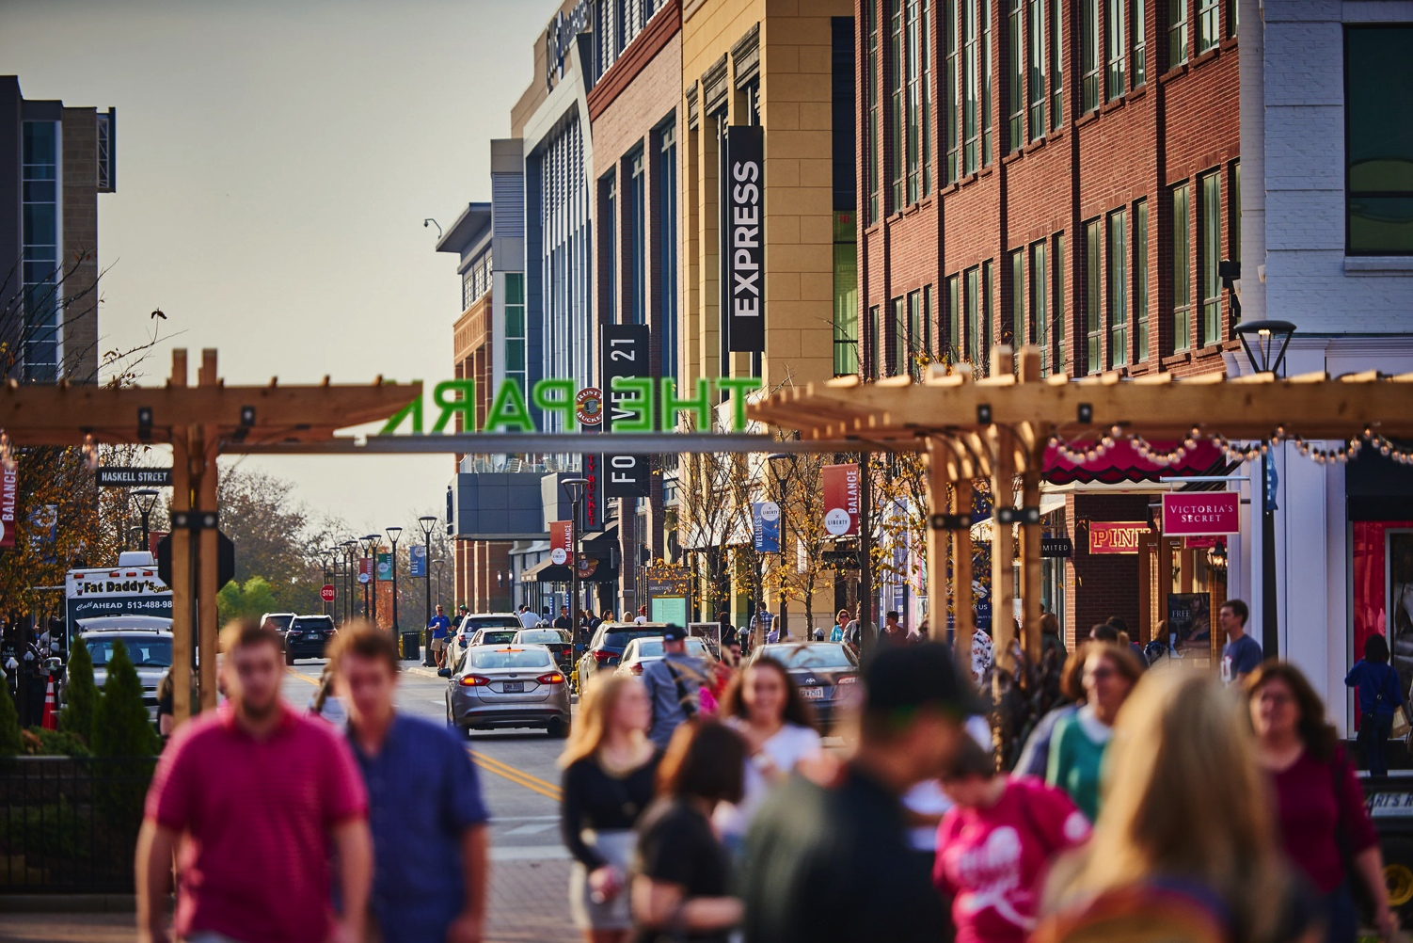
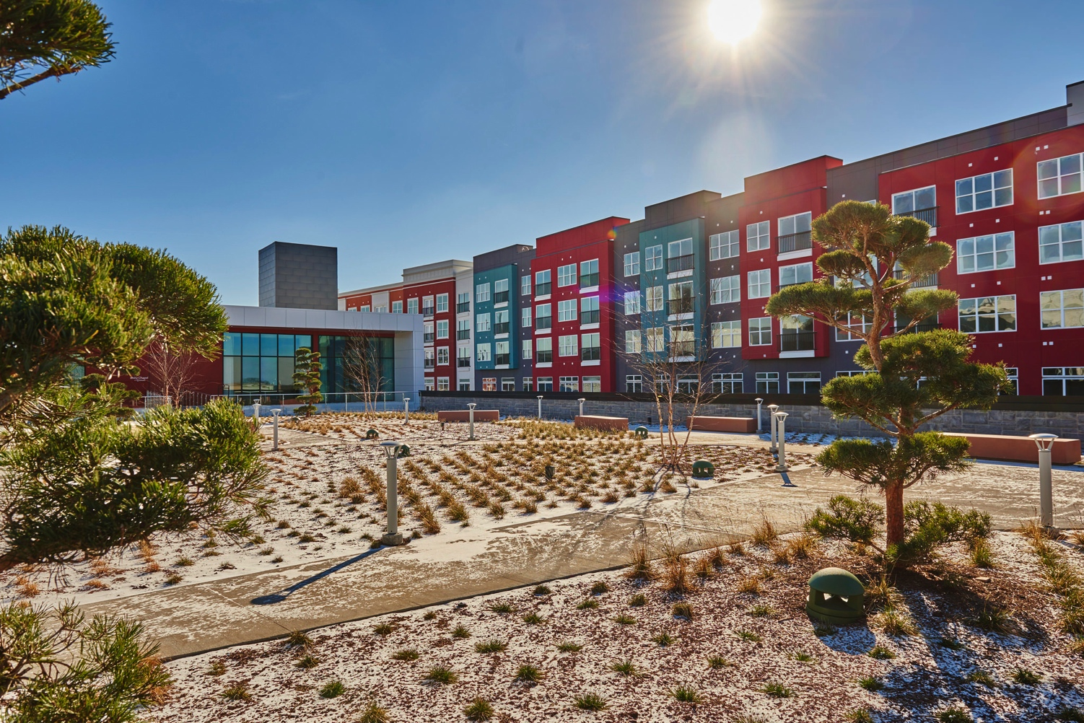
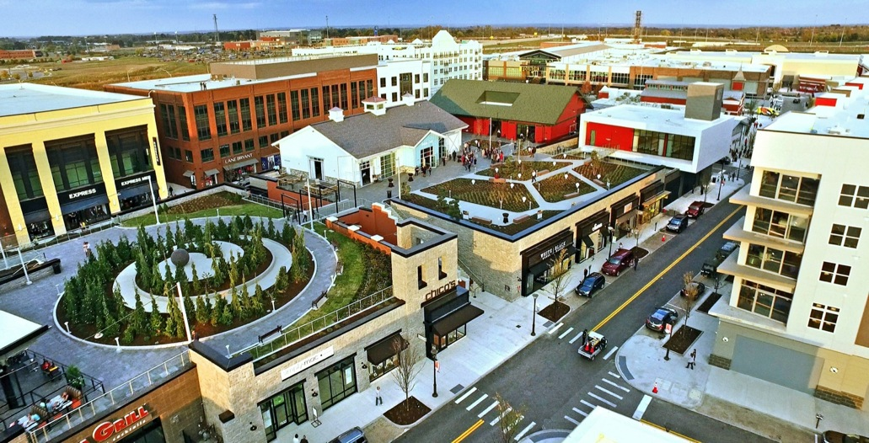
Case Study: LIBERTY CENTER
Location: North Cincinnati, Ohio
Phase I: 1,200,000sf (+ 430,000sf future)
Opened: October 2015
Phase I | Built | Future | Total
Retail | 850,000sf | 250,000sf | 1,100,000sf
Office | 75,000sf | 100,000sf | 175,000sf
Residential | 250 units |  | 250 units
Hotel | 130 keys | 120 keys | 250 keys

Slide 3
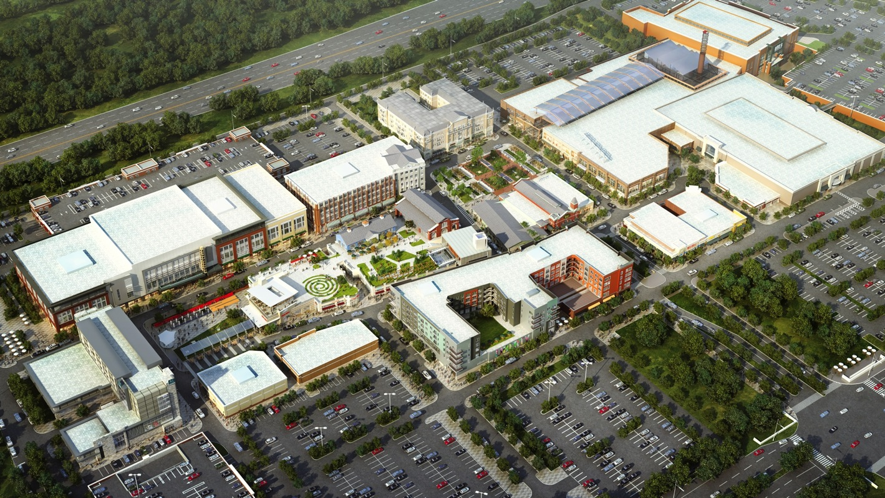
Case Study: LIBERTY CENTER
The Project: Anchors (Dillard’s, Dick’s Sporting Goods, Cobb Liberty Luxury 15 & CinéBistro)

Slide 4
Case Study: LIBERTY CENTER
The Project: The Foundry

Slide 5
Case Study: LIBERTY CENTER
The Project: Non-Retail Office, Hotel, and Residential

Slide 6
Case Study: LIBERTY CENTER
The Project: Public Parks

Slide 7
Case Study: LIBERTY CENTER
The Project: Public Amenities (Unity Chapel and Sabin Hall)

Slide 8
Case Study: LIBERTY CENTER
Layout Principle: The string of pearls……

Slide 9
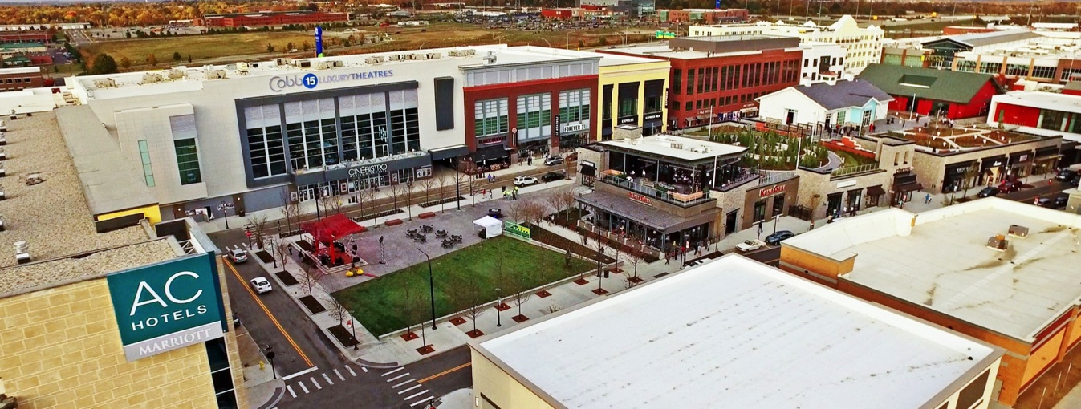
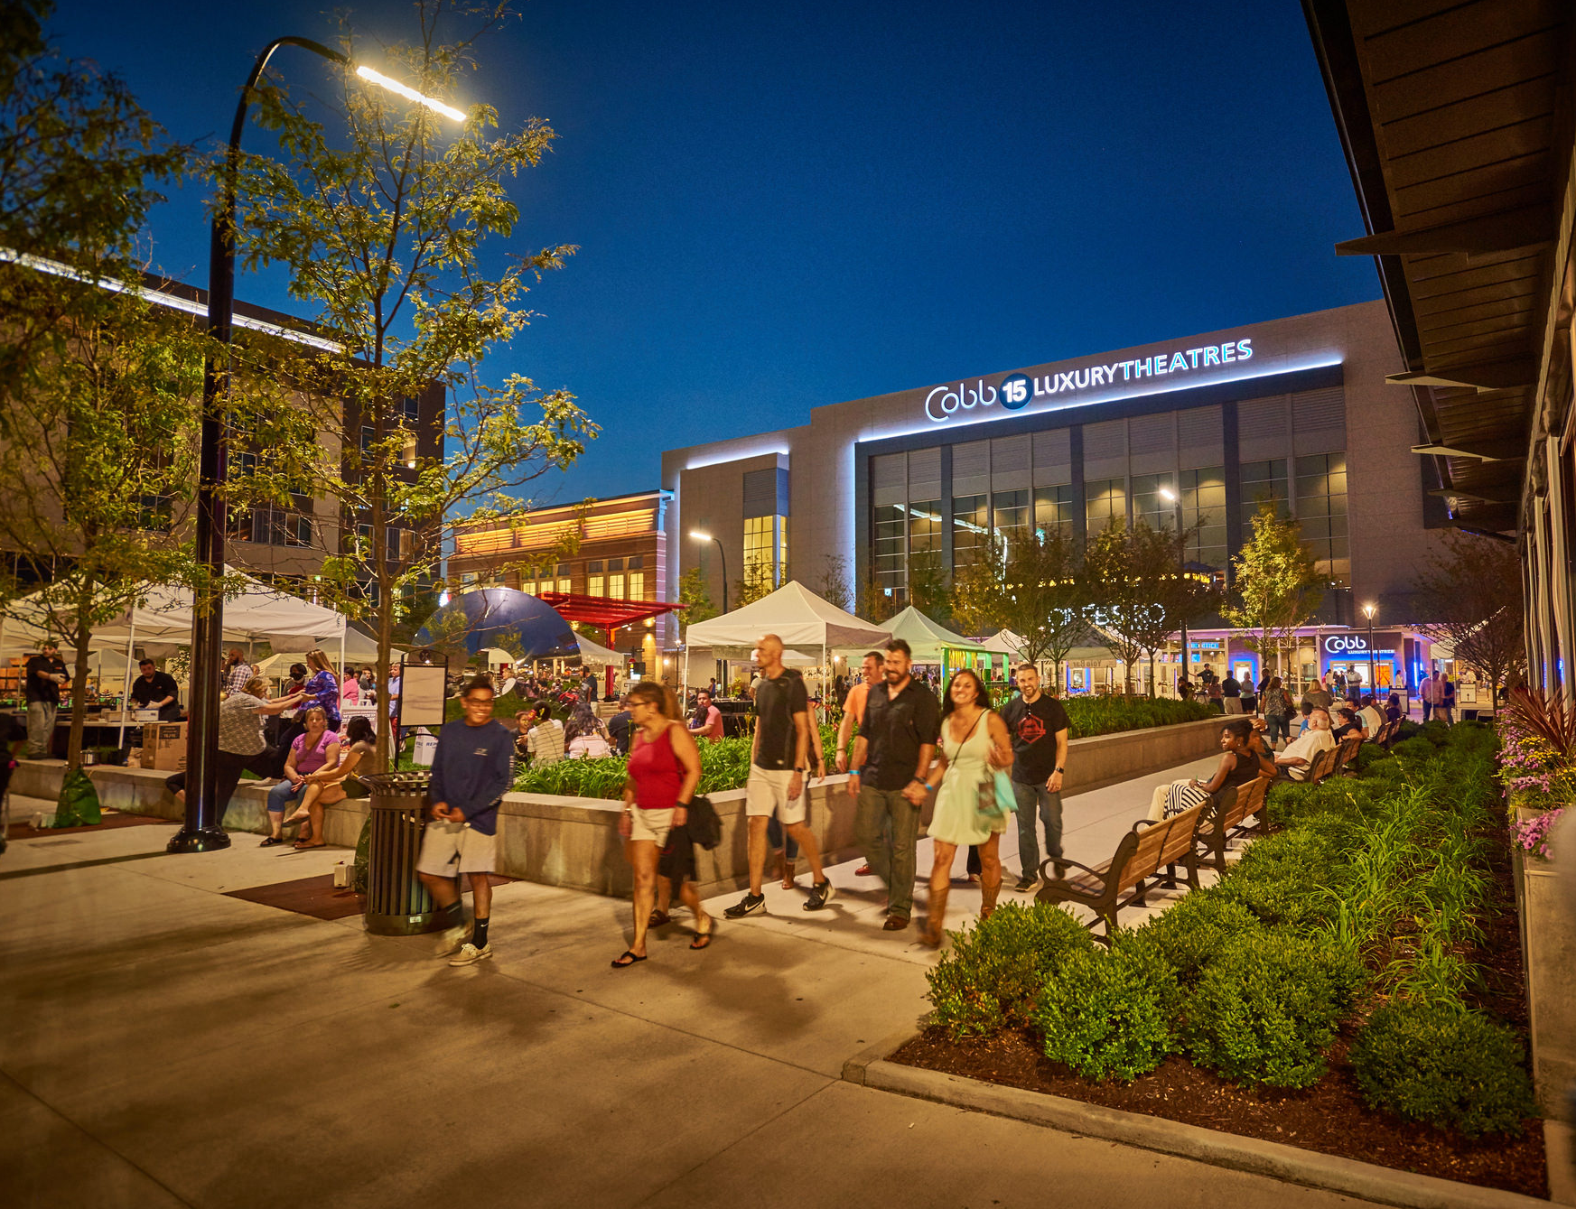
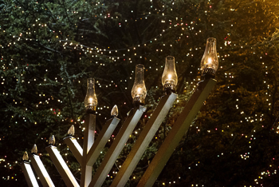
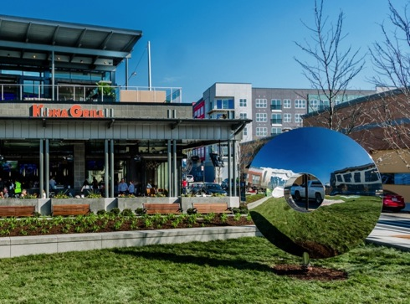
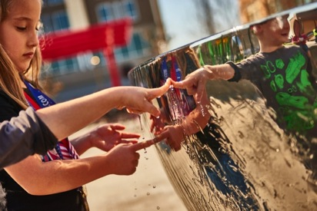
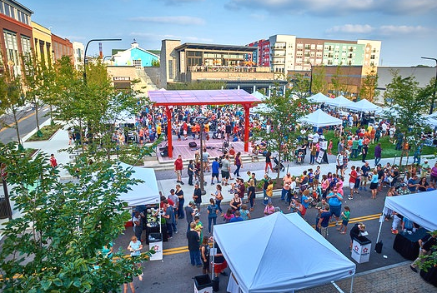
Case Study: LIBERTY CENTER
The Square

Slide 10
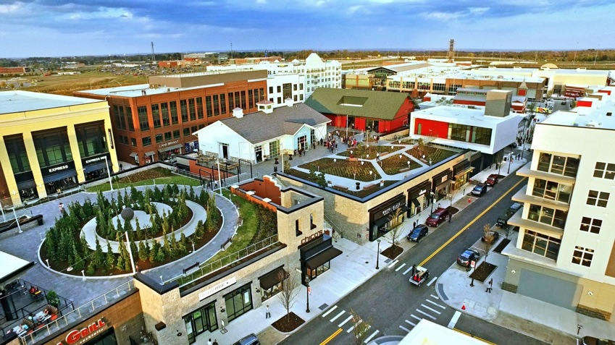
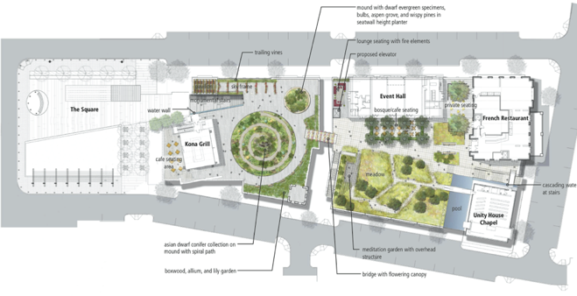
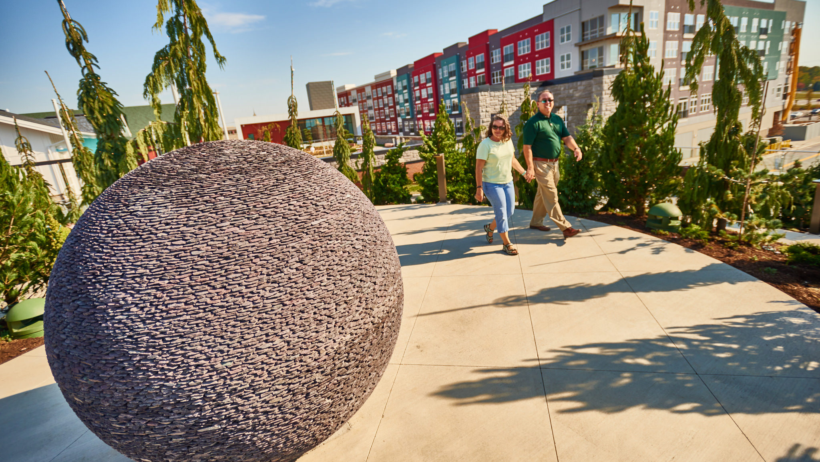
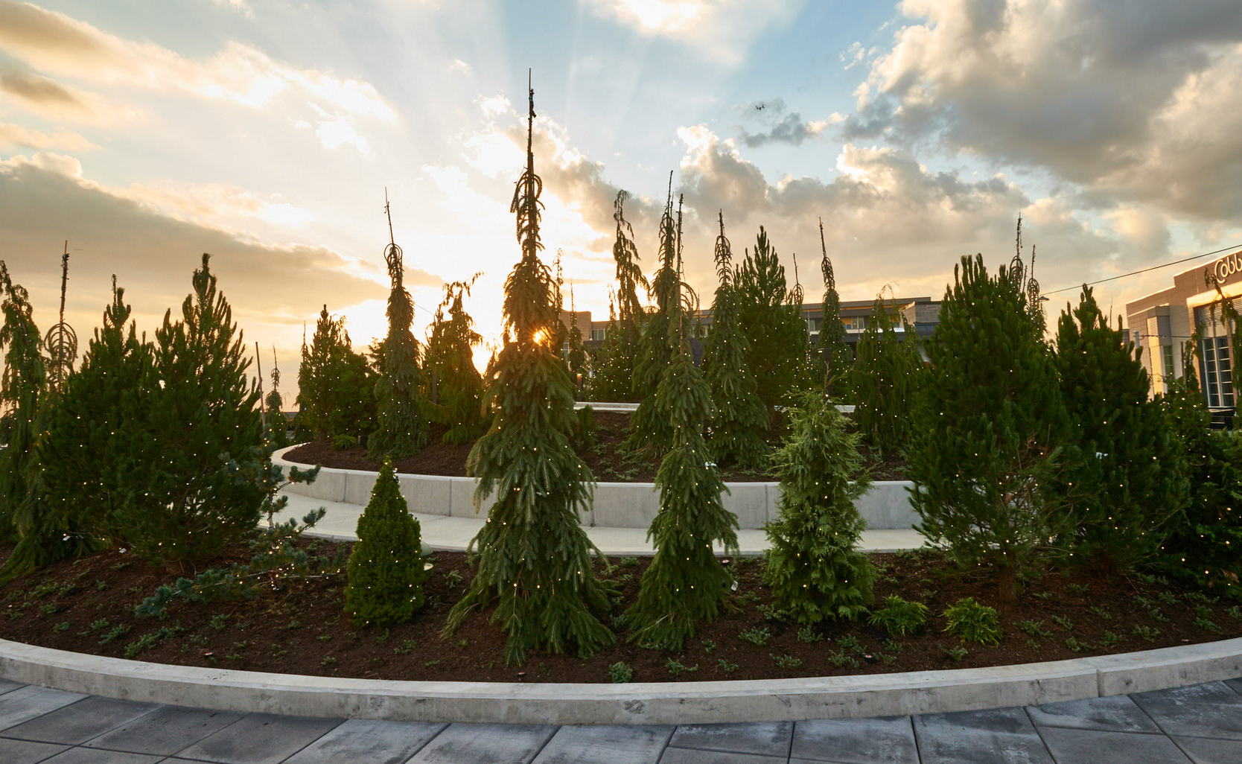
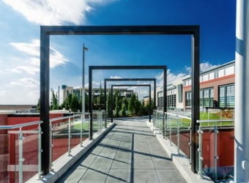
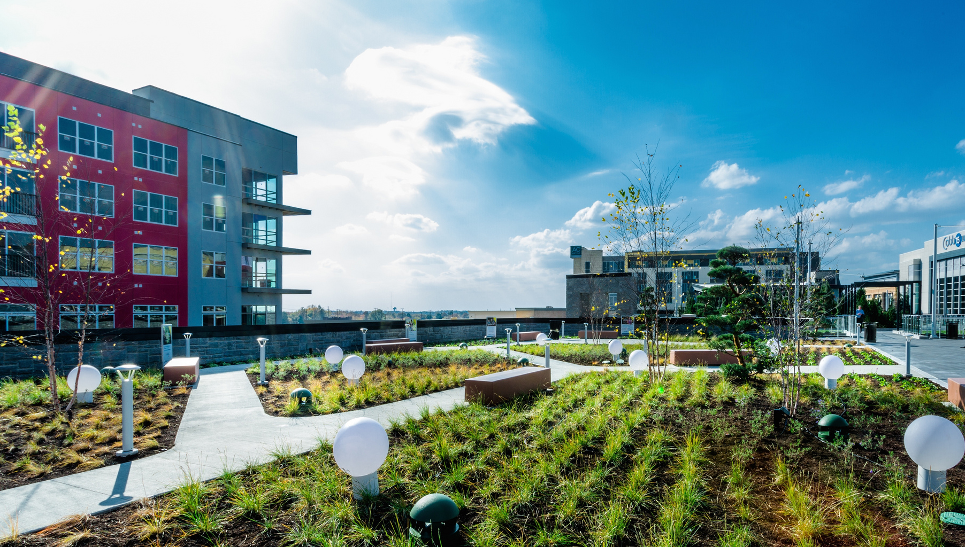
Case Study: LIBERTY CENTER
The Acropolis

Slide 11
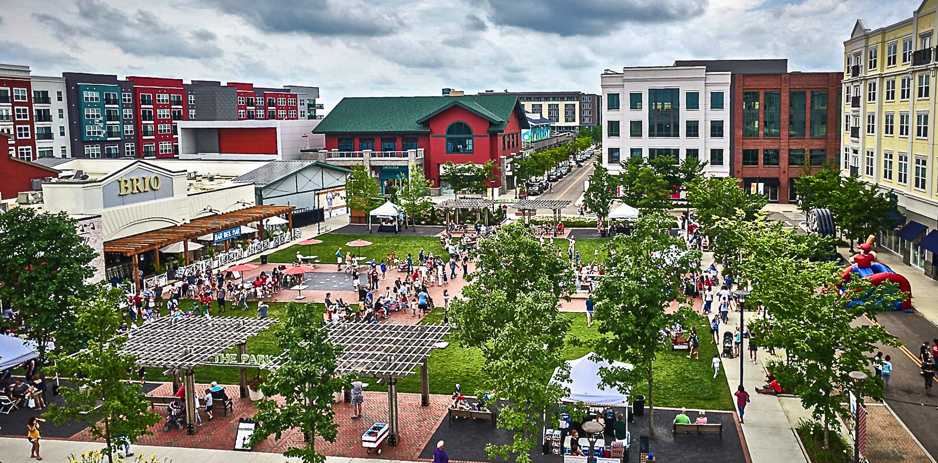
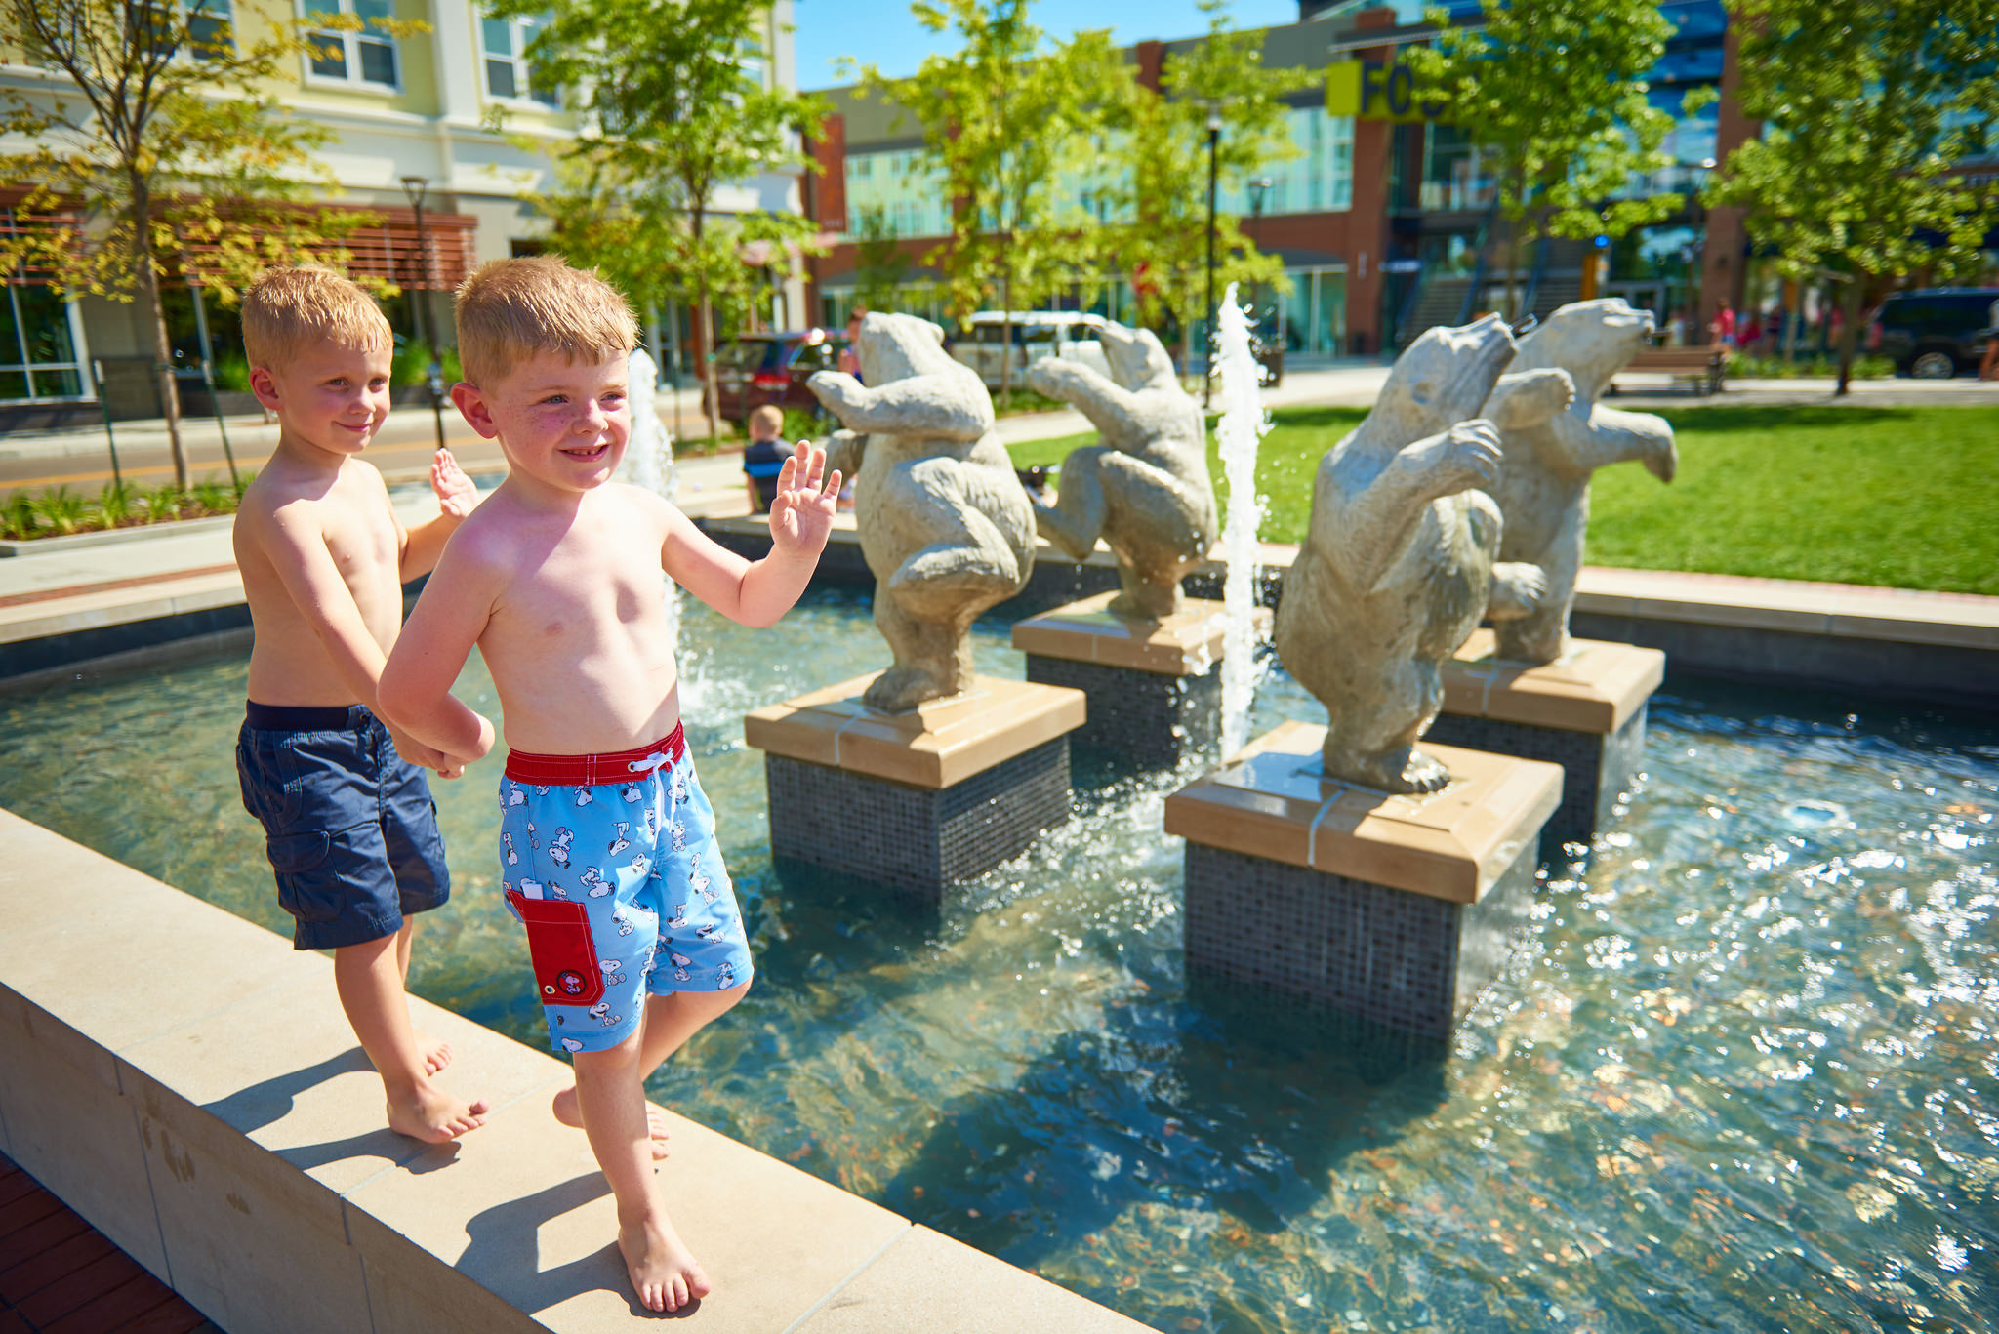
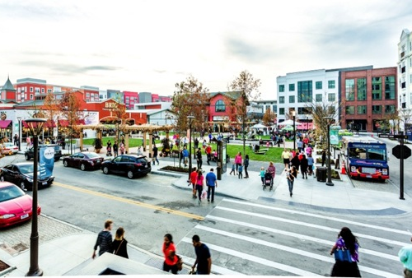
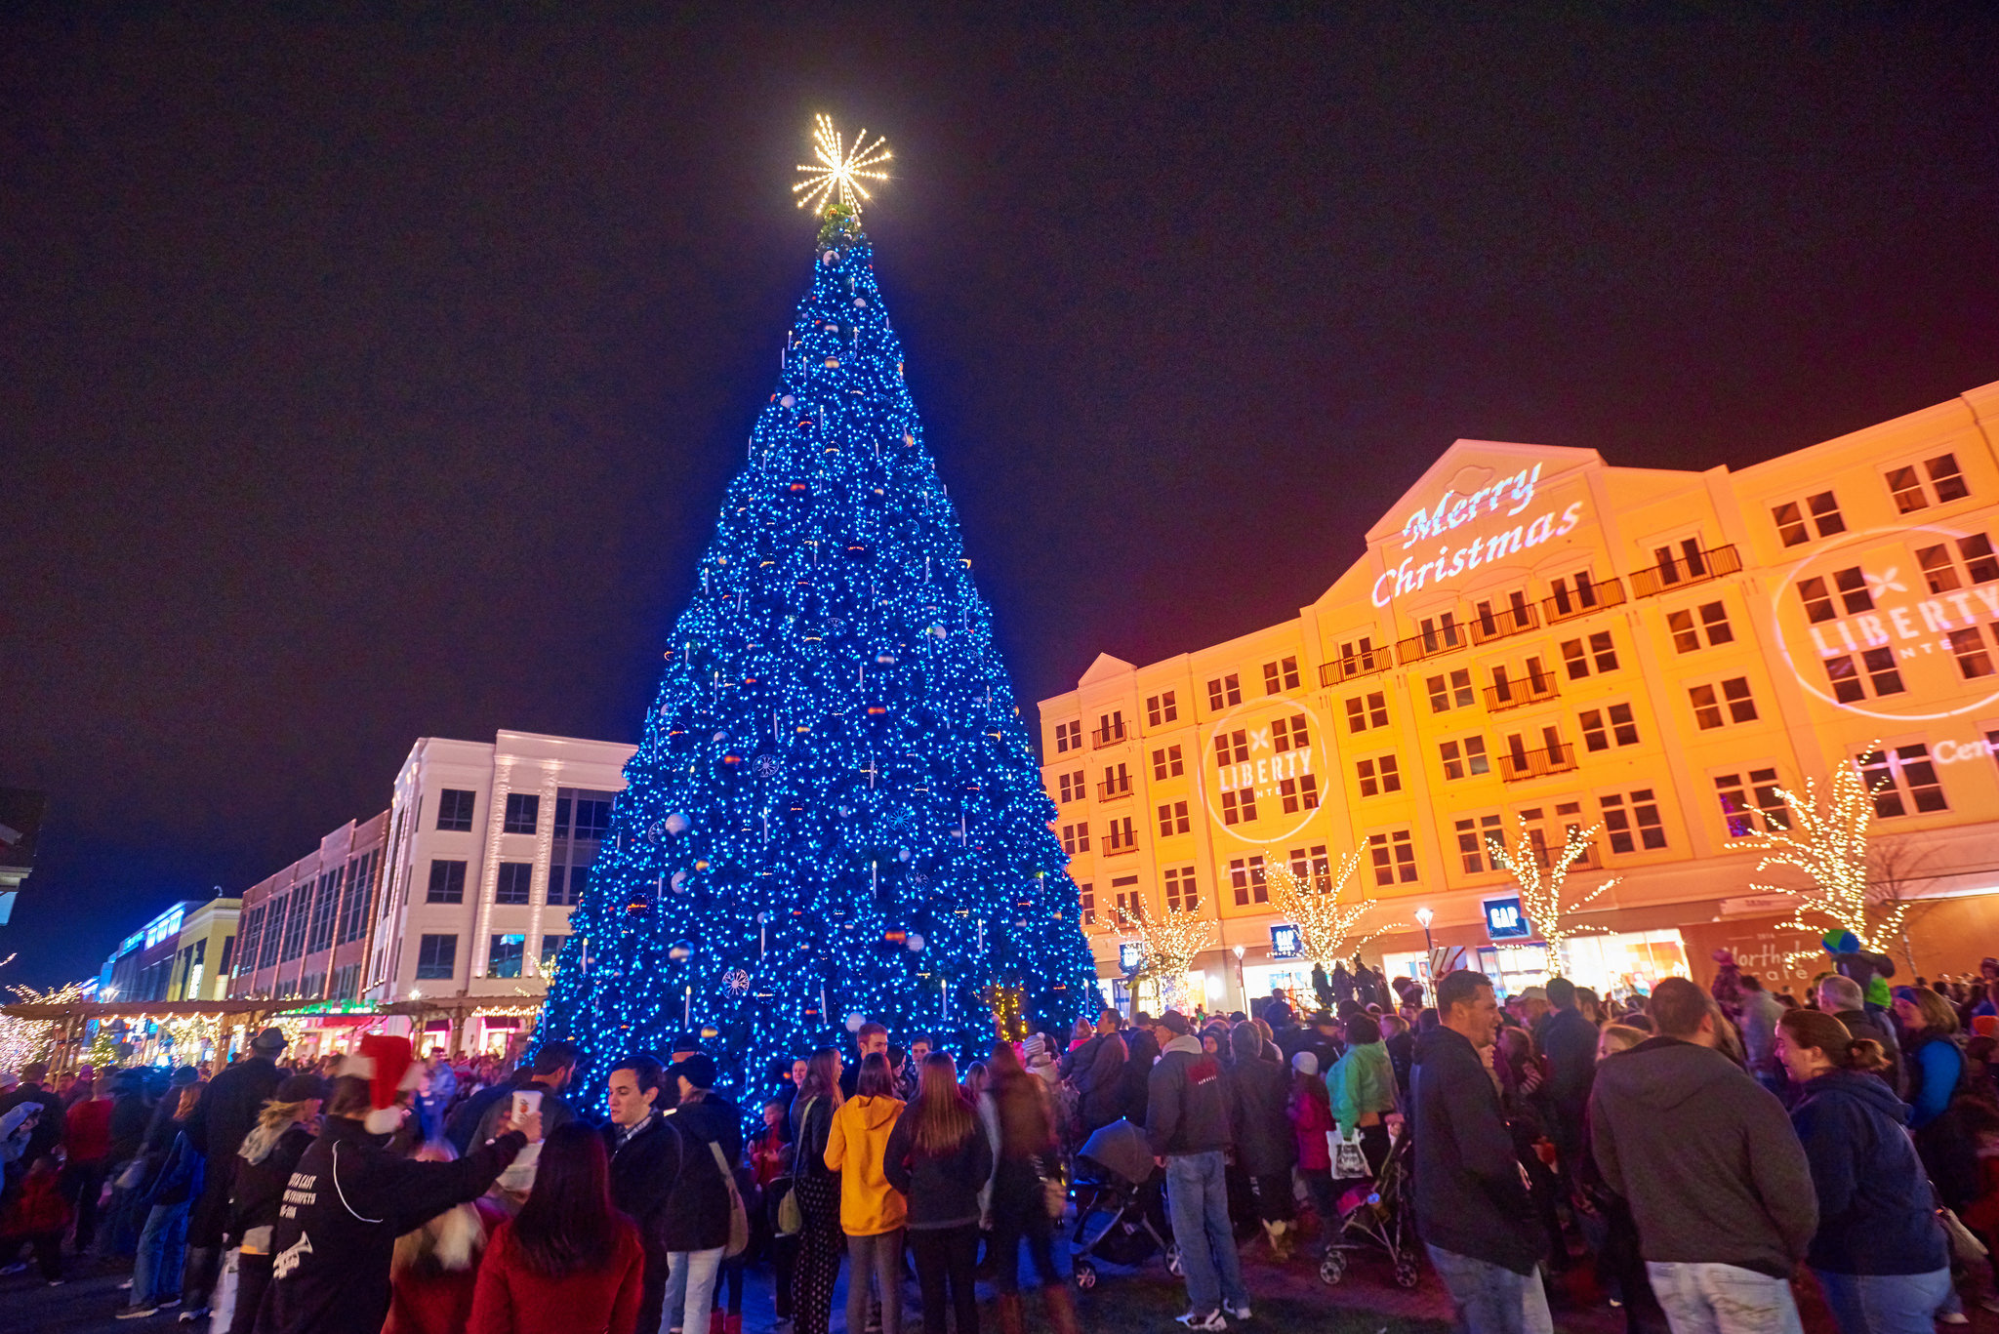
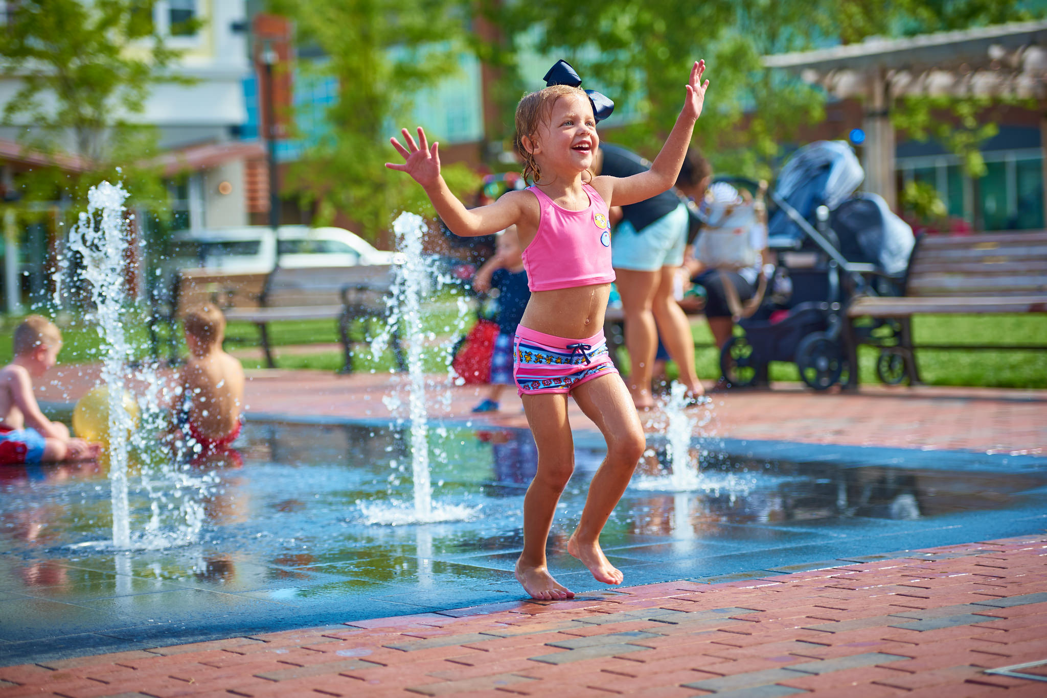
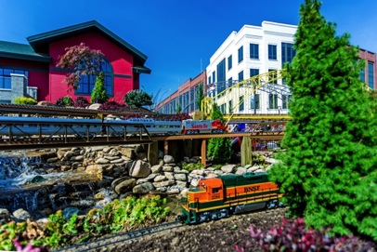
Case Study: LIBERTY CENTER
The Park

Slide 12
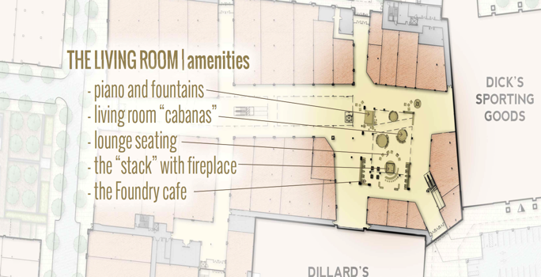
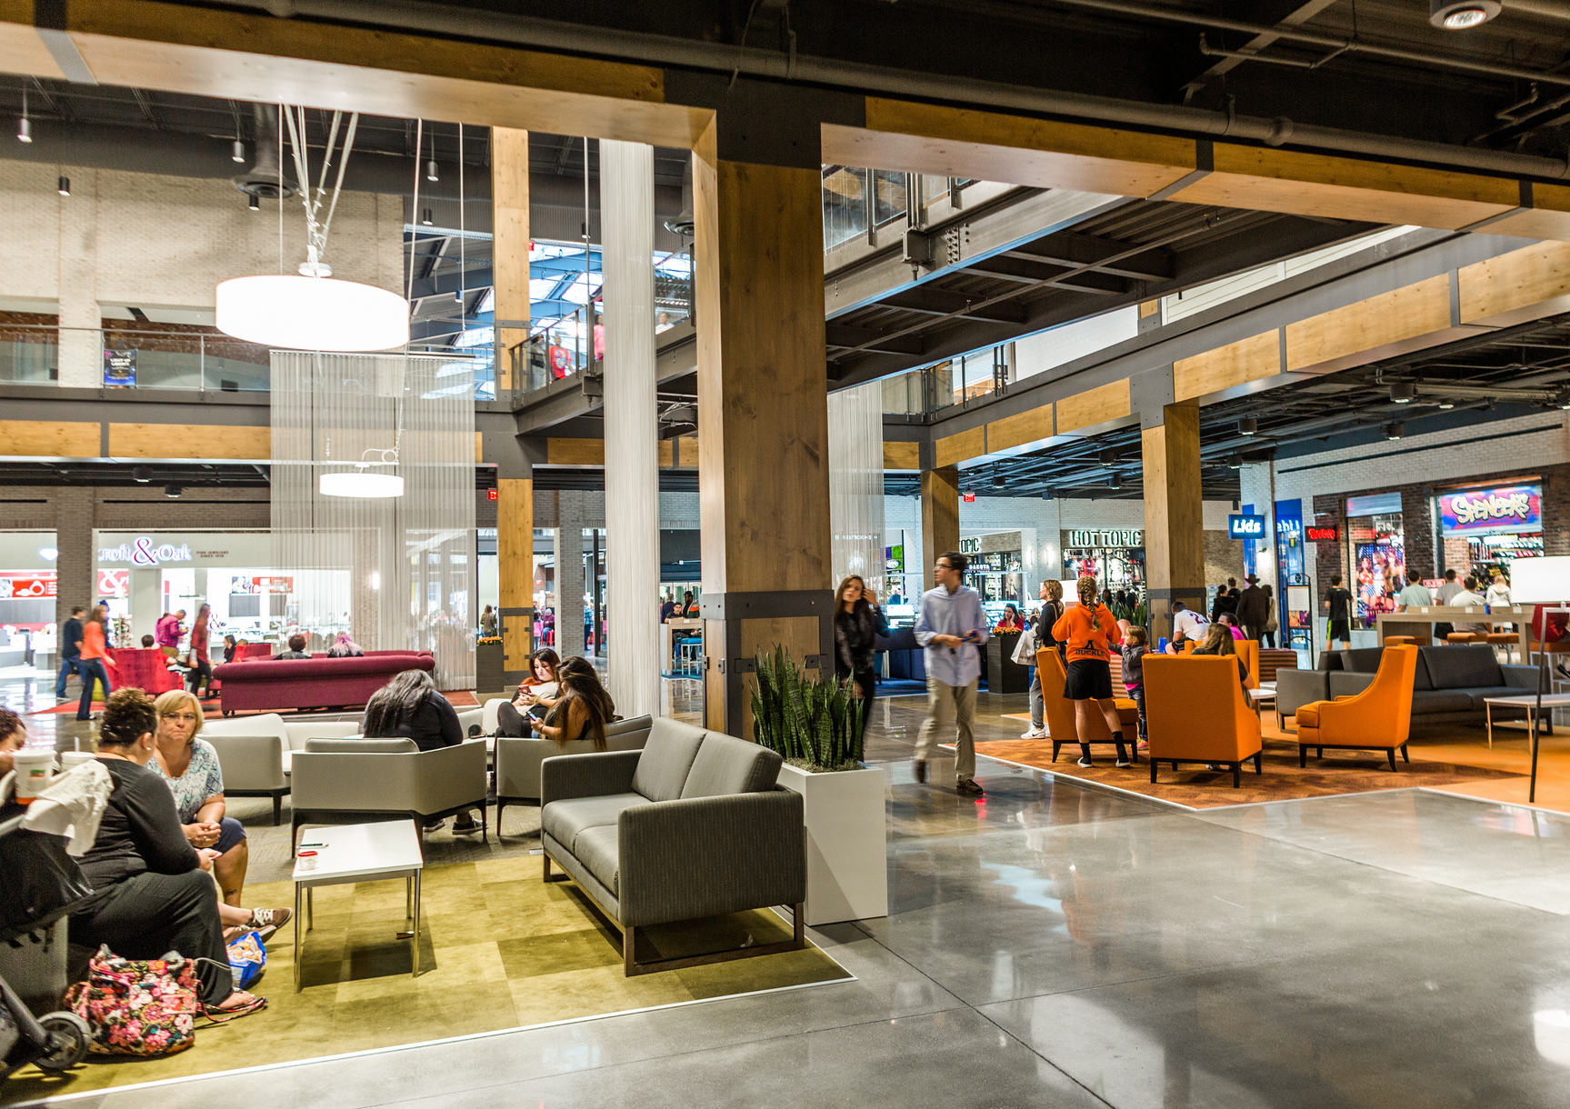
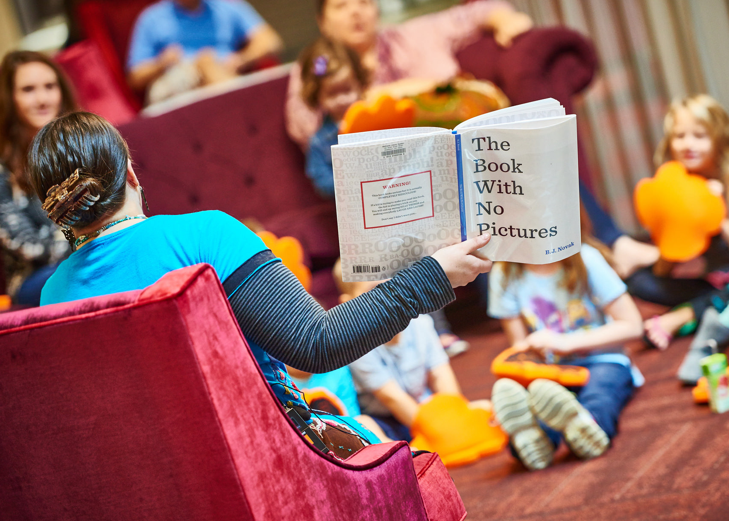
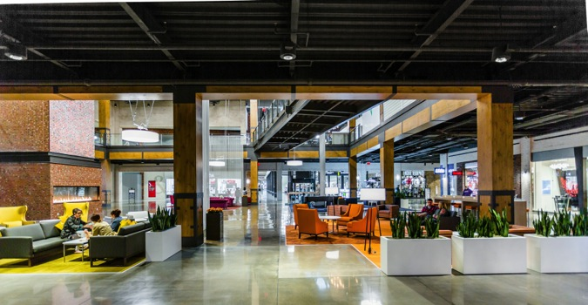
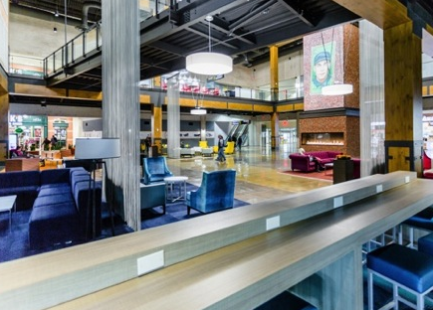
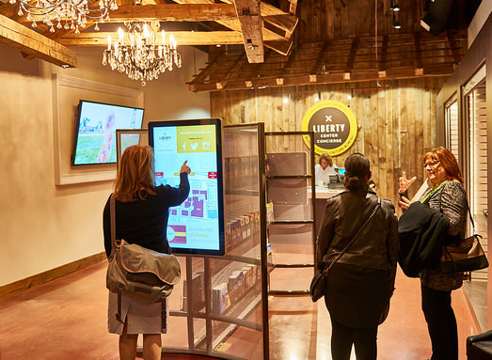
Case Study: LIBERTY CENTER
The Foundry: The Living Room

Slide 13
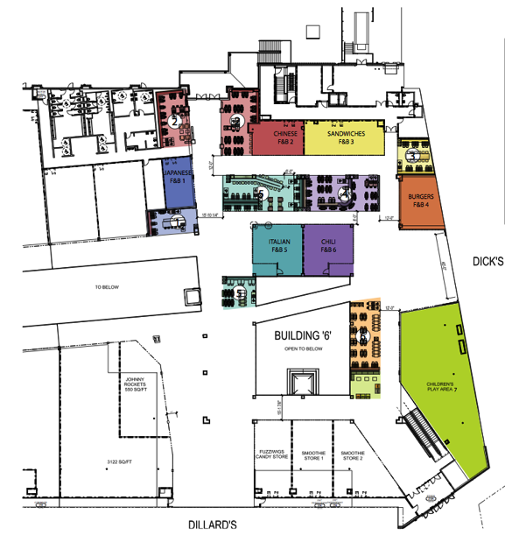
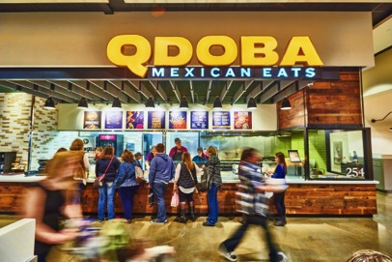
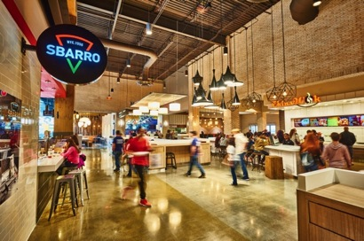
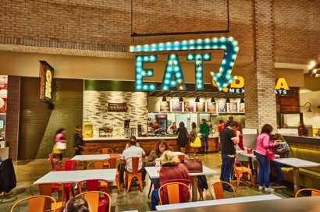
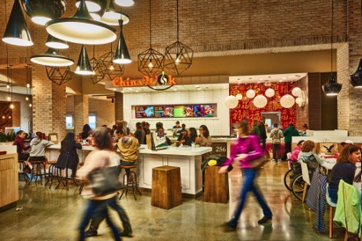
Case Study: LIBERTY CENTER
The Foundry: The Dining Hall

Slide 14
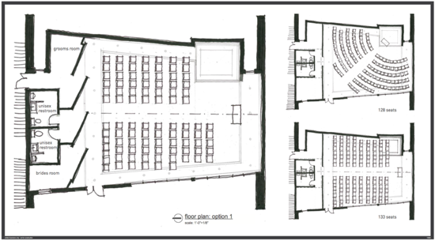
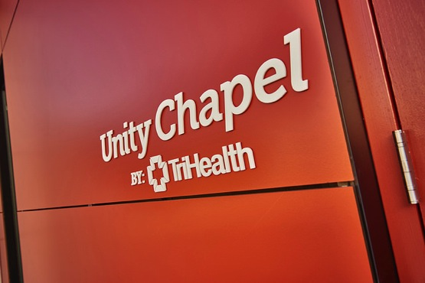
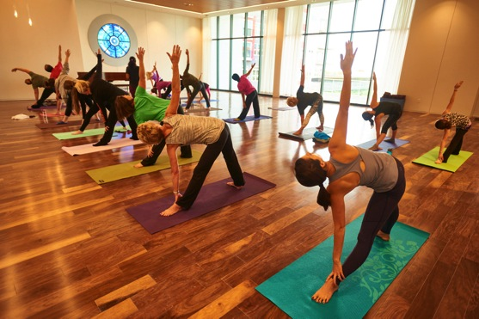
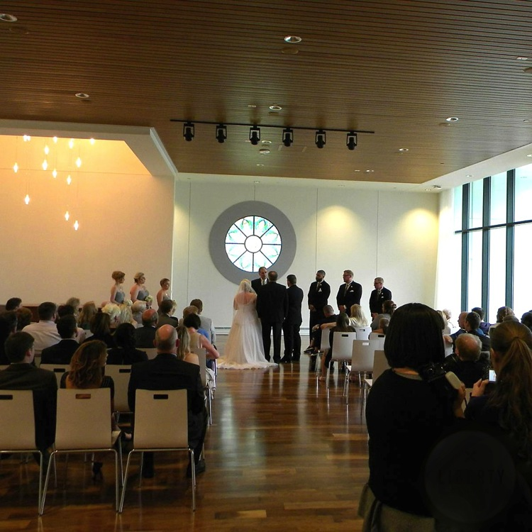
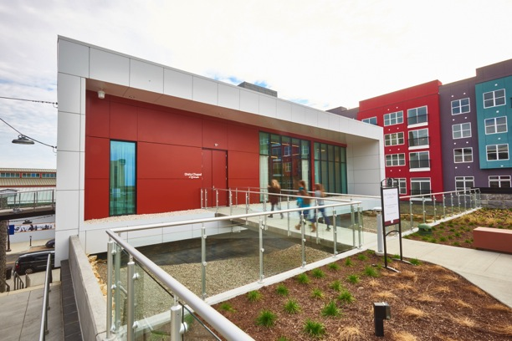
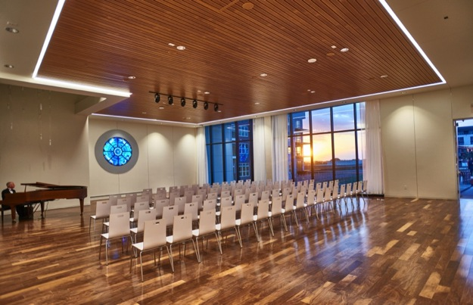
Case Study: LIBERTY CENTER
Unity Chapel by TriHealth

Slide 15
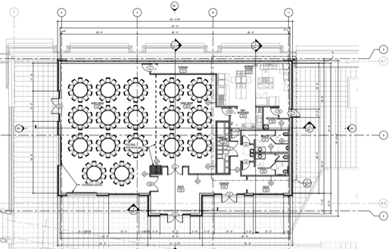
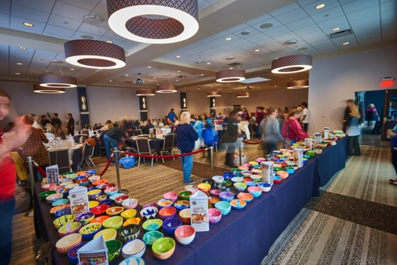
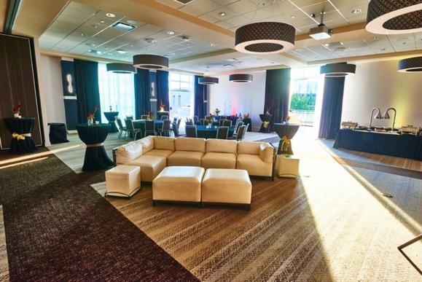
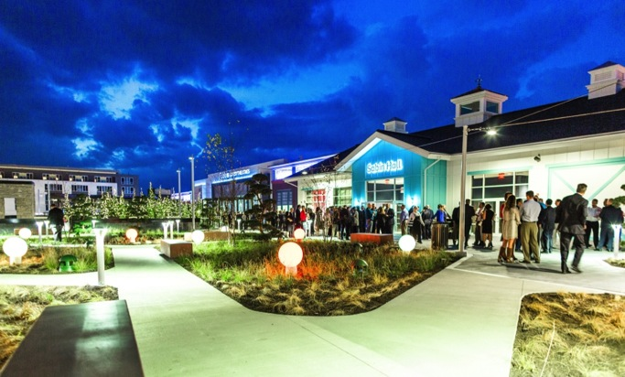
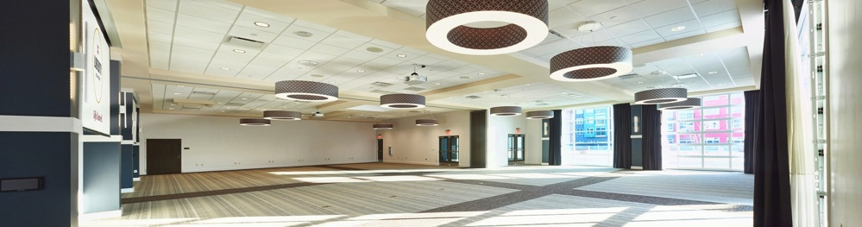
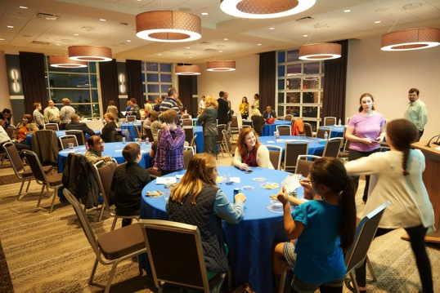
Case Study: LIBERTY CENTER
Sabin Hall by Cincinnati Children’s

Slide 16
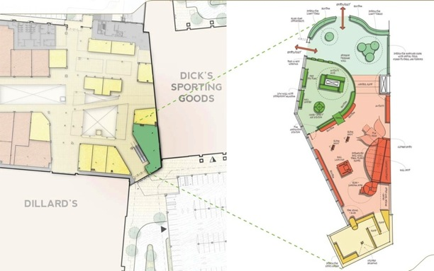
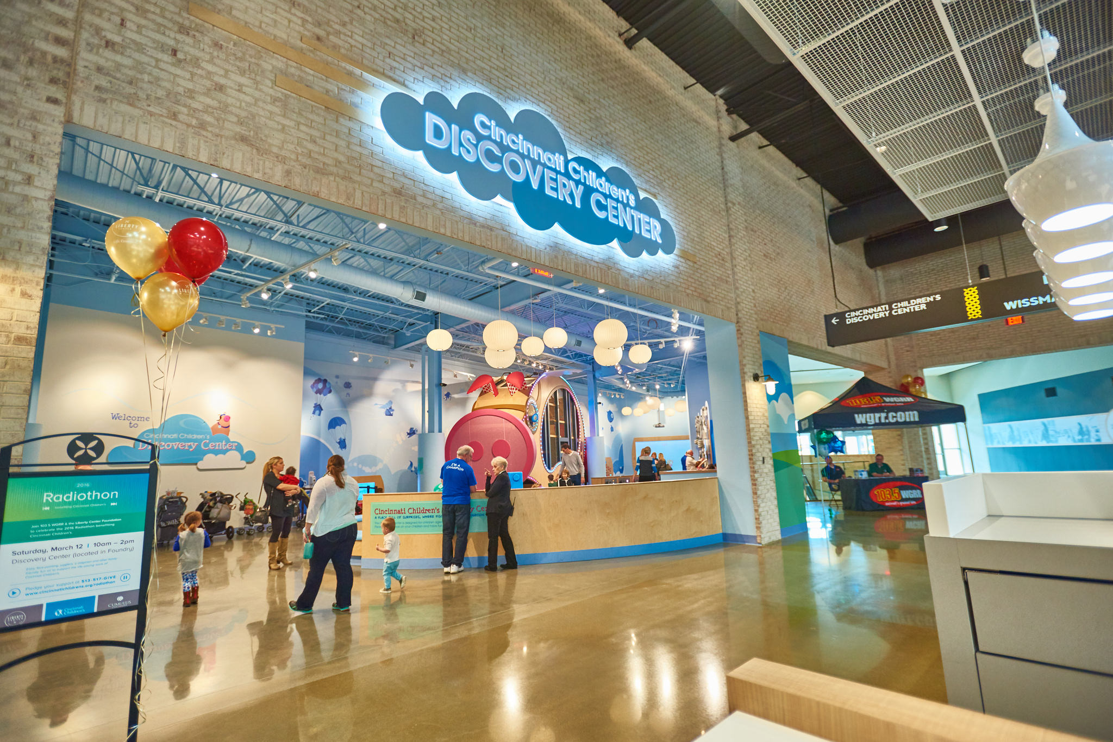
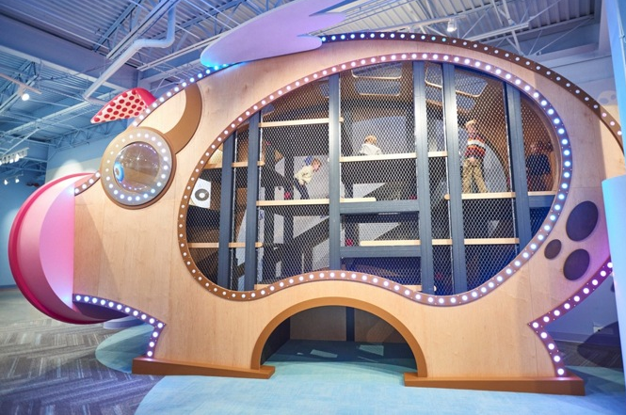



Case Study: LIBERTY CENTER
Cincinnati Children’s Discovery Center

Slide 17

Case Study: LIBERTY CENTER
How did we execute Liberty Center?
Integration of non-retail uses
Anchoring with leisure time uses
Public-Private partnership
Community Partnership structure
Global economics

Slide 18



Case Study: LIBERTY CENTER
1. Integration of non-retail uses
 | Now | Future
Office | 75,000sf | 300,000sf
Residential | 250 units | 150 units
Hospitality | 130 keys | 150 keys

Slide 19
Case Study: LIBERTY CENTER
1. Integration of non-retail uses: project size reduction
Total Project $310 M
Retail $230 M
Residential $45 M
Hotel $20 M
Office $15 M

Slide 20














Case Study: LIBERTY CENTER
2. Creative Anchoring with leisure time uses
Dillard’s |  | 200,000sf
Dick’s Sporting Goods |  | 80,000sf
Leisure Time Uses:
- Cobb CinéBistro | 80,000sf
- Funny Bone Comedy | 8,000sf
- Restaurants | 70,000sf
 |  | 158,000sf

Slide 21
Case Study: LIBERTY CENTER
3. Public-Private Partnerships
Contributions:
- Butler County Bonds $10,000,000
- Liberty Township Bonds $ 5,000,000
- Liberty Community Authority $16,000,000
- Ohio Water Development Authority $12,000,000*
Total $43,000,000
PRIVATE
Liberty Center LLC
Steiner + Associates
PARTNERSHIP
Butler County Port Authority
(funding $43M)
Repayment Sources:
- Existing TIF zone $15,000,000
- Special Assessment/0.5% sales tax $28,000,000
Use of Funds:
- Off-site road improvements $ 4,300,000
- Utility extensions $ 4,500,000
- Parking garages $25,700,000
- Underground water storage $ 8,500,000
PUBLIC
Butler County, Ohio
Liberty Township
Ohio Department of Water Resources
Liberty Community Authority
* Loan

Slide 22







Case Study: LIBERTY CENTER
4. Community Partnerships
Naming, Animation, and Programming Rights:
Exclusive naming rights for community assets
Host event and programs at the named venues
Exclusive use at mutually agreeable dates
Primary Sponsor of Signature Event
Selection for Change for Charity recipients
Enhance sponsored community venues

Slide 23




Case Study: LIBERTY CENTER
4. Community Partnerships: financial model
Community Resources:
Owner
  - initial equity
  - annual operating contributions
Community Partners
  - initial equity
  - annual operating contributions
Creation of Public Amenities and Programming of Community Events

Slide 24

Case Study: LIBERTY CENTER
5. Global Economics
Projected Cost Summary:
- Retail project costs $230,000,000
- Non-retail project costs
  Residential $45,000,000
  Hotel $20,000,000
  Office $15,000,000
$ 80,000,000
- Community amenities $ 10,000,000
- Public infrastructure $ 43,000,000
Total $348,000,000
Projected unleveraged returns:
- Retail 8.75%
- Residential 7.75%
- Office 9.50%
- Hotel 11.50%
- Community Partnerships 8.00%

Slide 25
An example of the creation of a sustainable mixed-use environment

Slide 26

Q & A
Yaromir Steiner
Steiner + Associates
ysteiner@steiner.com

